Slide 1
Complete a simple FSM project: LLM vs Human
Team 6 HW 4
Made by : He Zicheng, Liu Kaixin, Yang Runkang

Slide 2

Introduction：
Vending machine
LLM
Design
Evaluate
Human
Design
Evaluate
Train LLM
Generate
System block
State transition

Slide 3


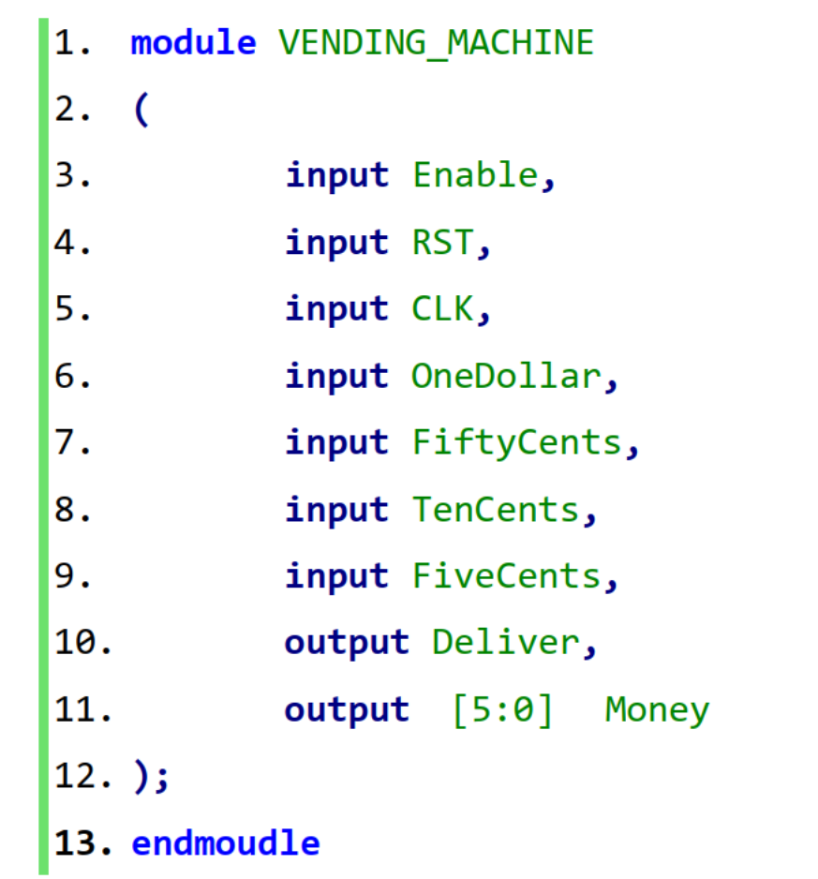
Vending machine:
Goal：
Design a vending machine based on specific requirements
Deliver products as soon as the input money exceeds its price
5 cents
10 cents
50 cents
1 Dollar
Fig2: Acceptable coins
Fig3: Top module port
Fig1: Vending Machine

Slide 4
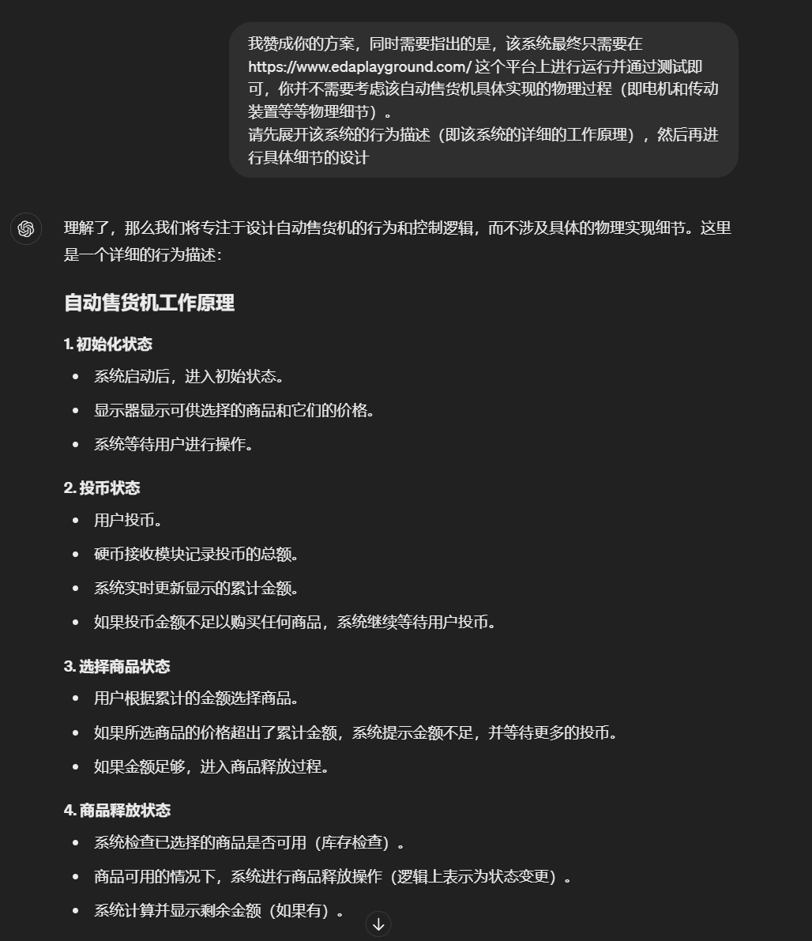
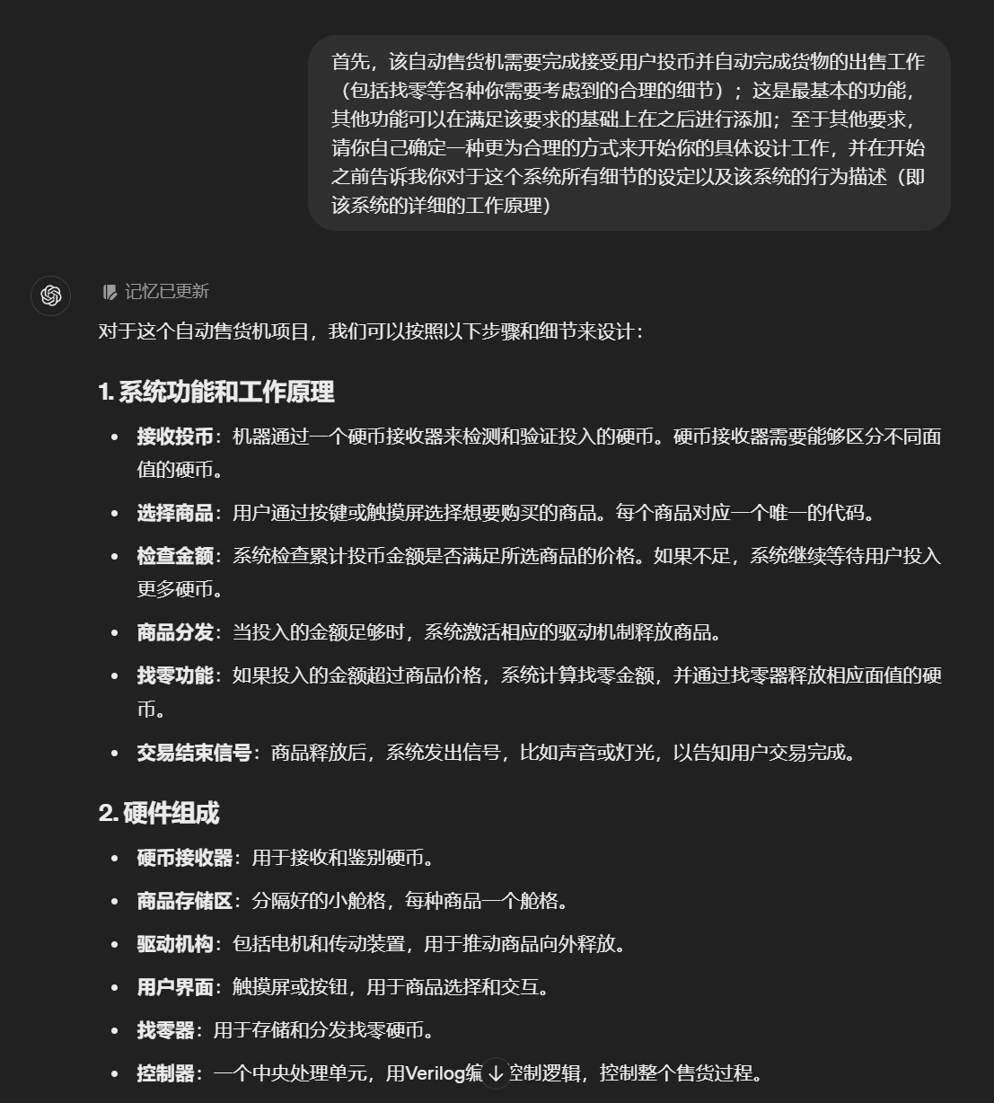
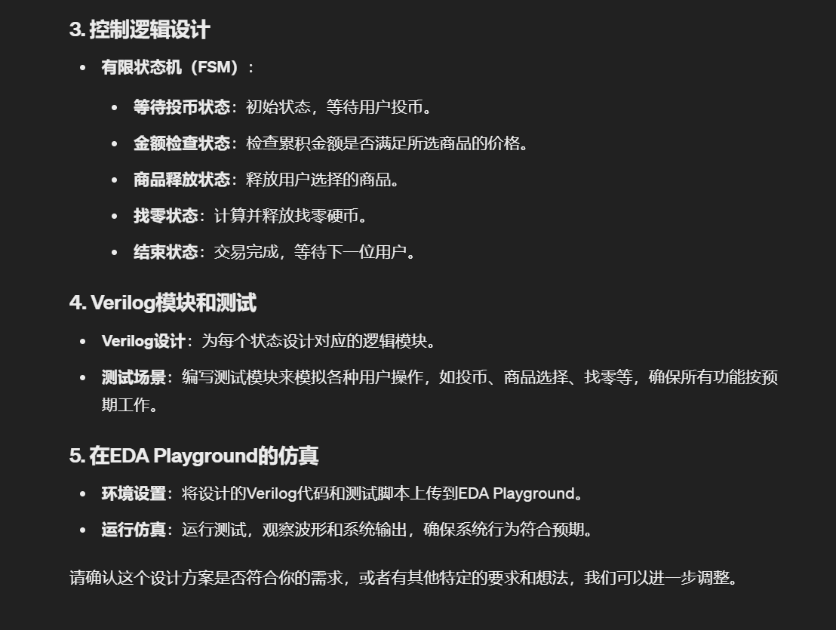
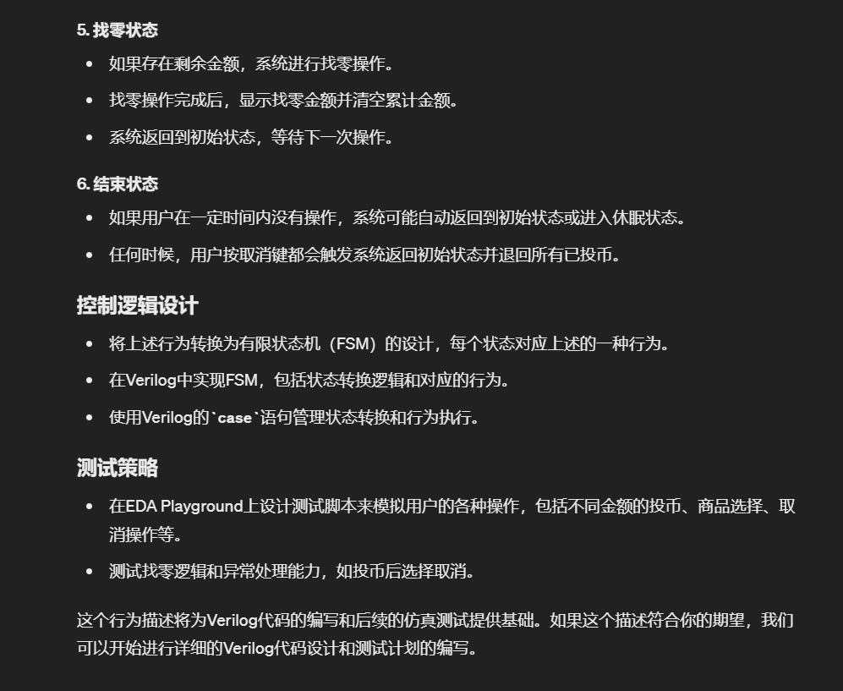
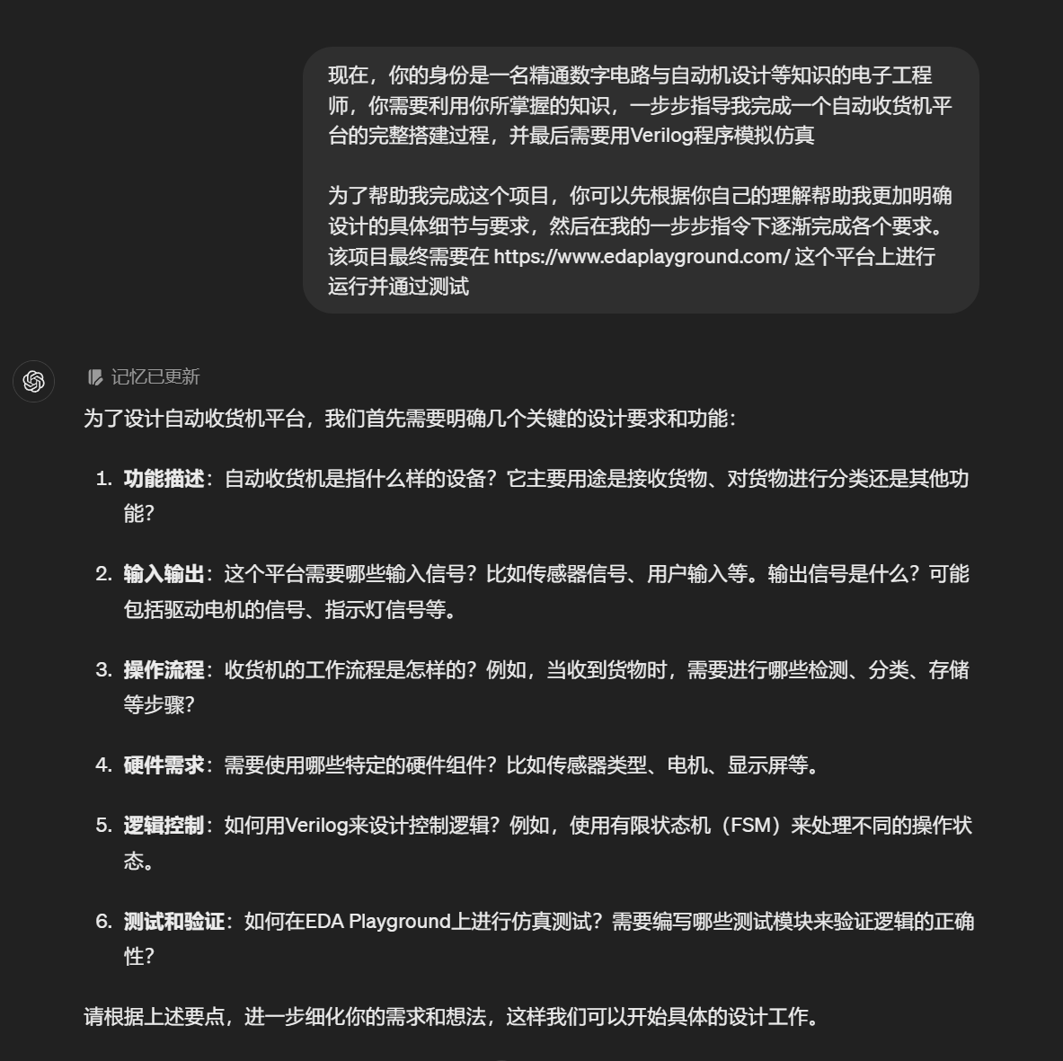
LLM design - Training:
Step 1：
Specify a target
Step 2：
Add details
Step 3：
Check FSM and modify the details.

Slide 5
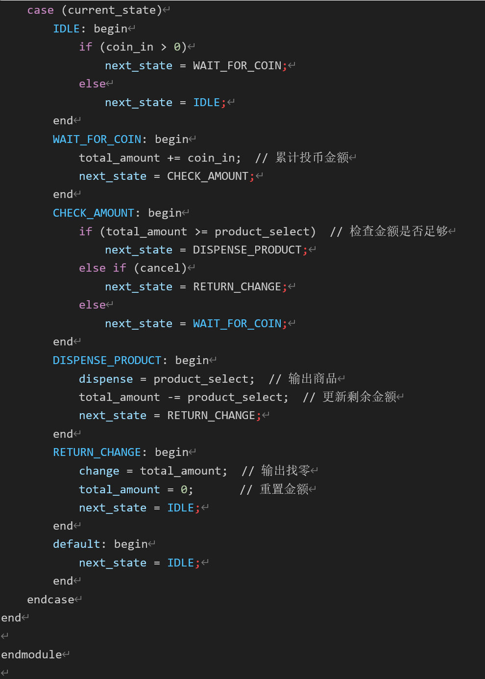
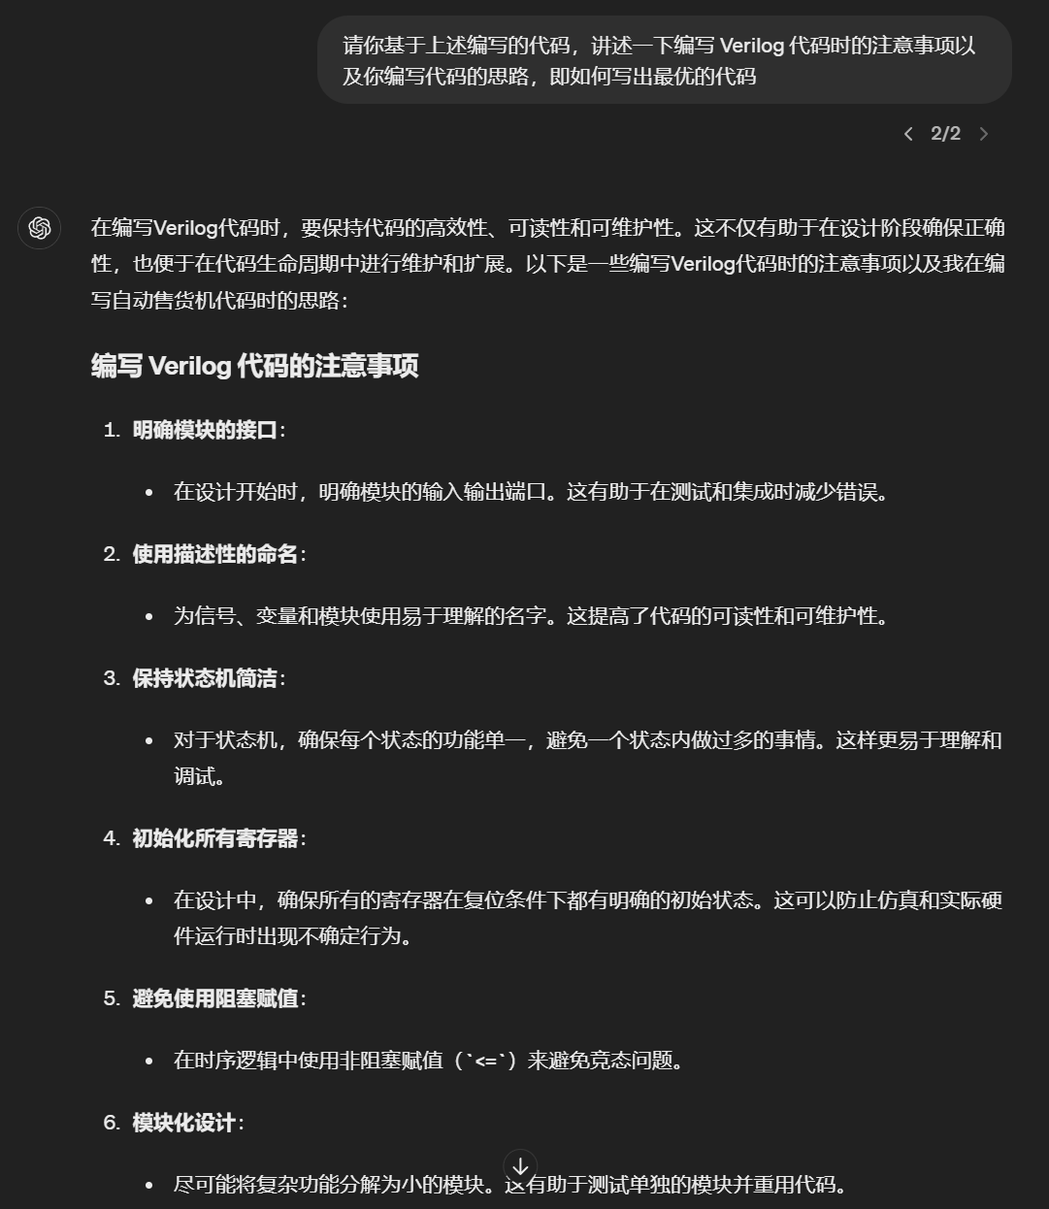
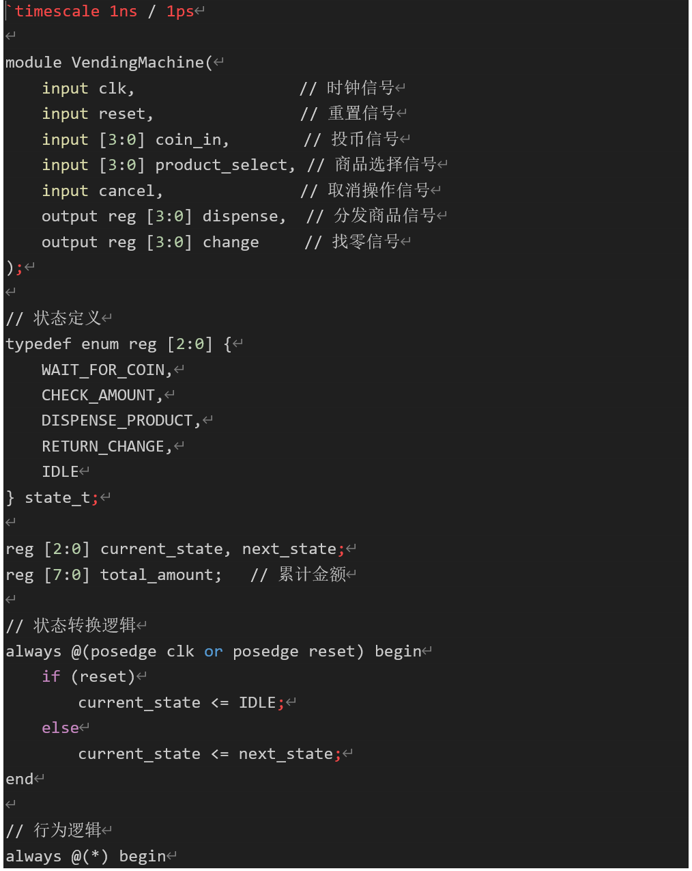
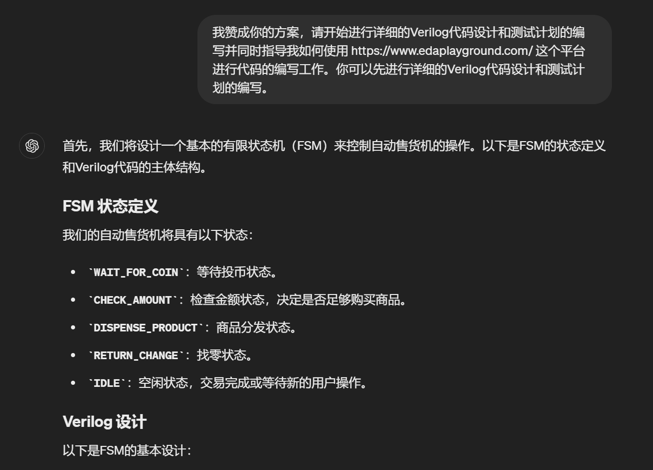
LLM design - Generating:
Step 4：
Generate the code

Slide 6
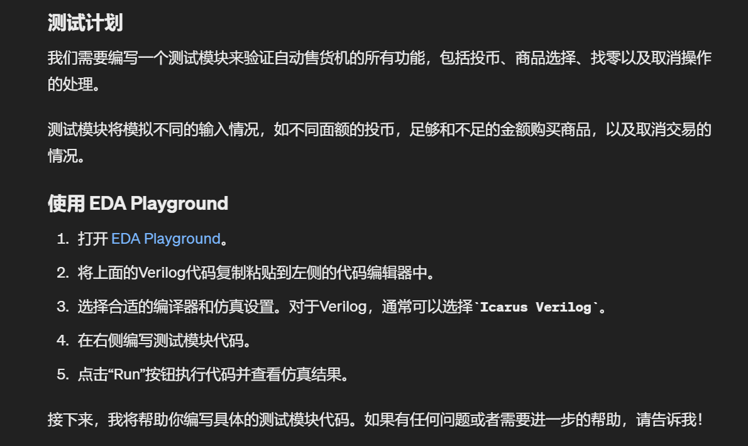
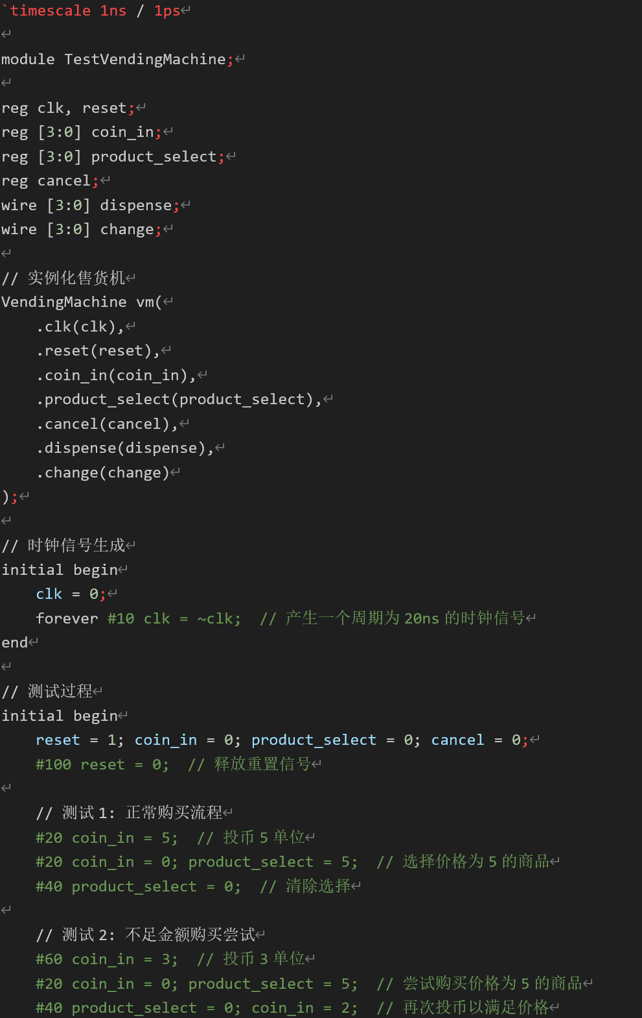
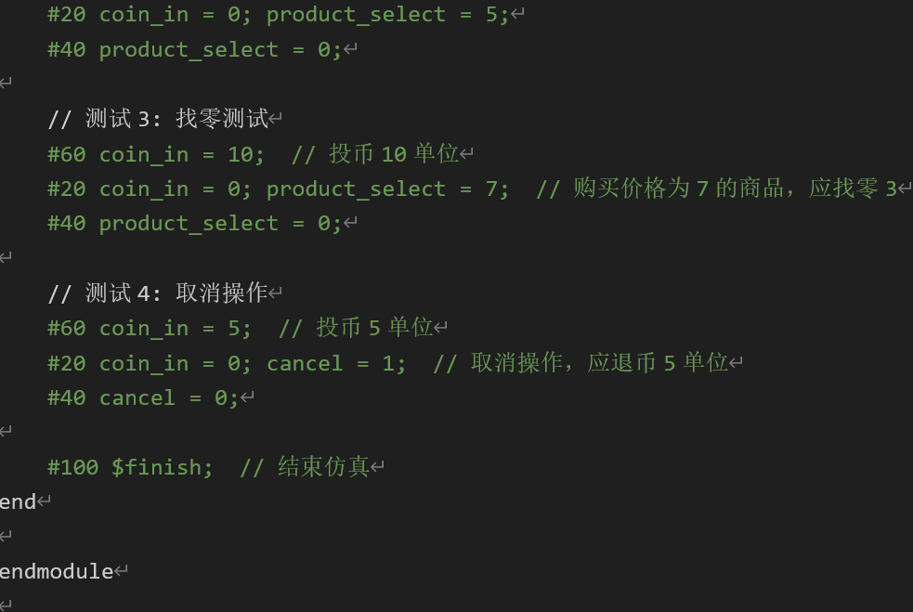
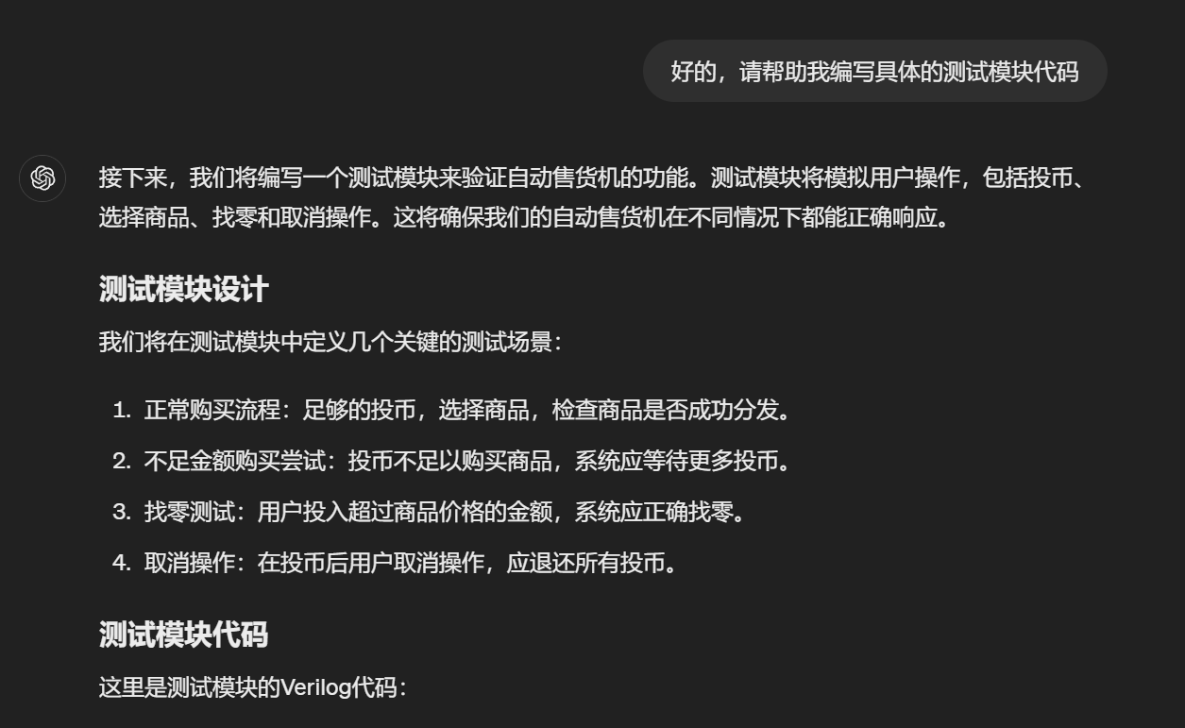
LLM design - Generating:
Step 5：
Generate testbench:

Slide 7
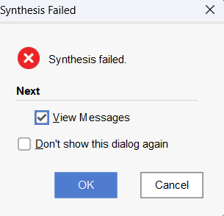
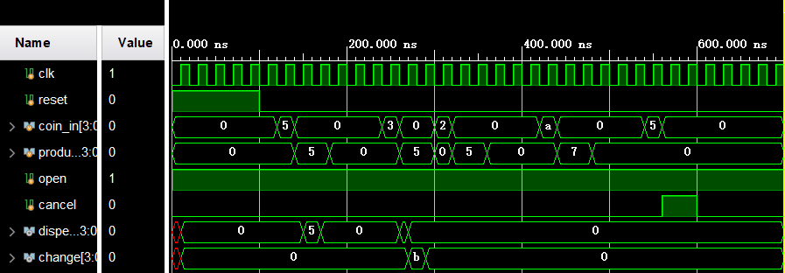
LLM design - Evaluate:
Problems：
The programing didn’t consider sequential logic. This doesn’t in line with the actual situation
Some code habits used in the code doesn’t meet the standards.

Slide 8
Human – design:
The implementation of the algorithm can be divided into control module, data processing module and key shake elimination module
The debouncing module is written separately and called in the Vending Machine module. When the input is not bouncing, the Vending Machine can also work normally without the debouncer
Use FSM to tackle sequential logic
Separate combinational logic and sequential logic
Draw state transition diagram and system block diagram before writing Verilog code
All the states, modules and signals have meaningful names

Slide 9
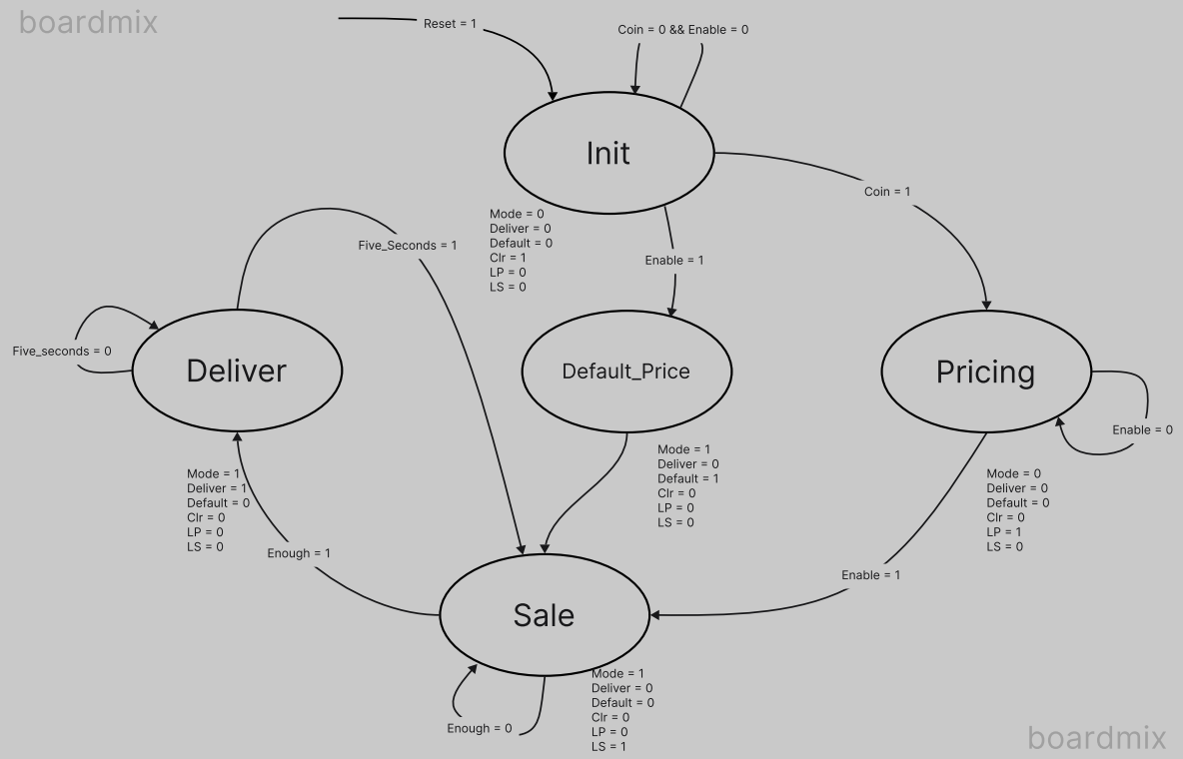
Human – design state transition:
The input of each coin will generate a pulse wave at its corresponding input ports，and 2 pulse wave won’t be generated at the same time!!!
We enter selling mode only when “Enable” is actively high. When “Enable” is actively low，it is in pricing mode. Default price (which is needed when pricing is skipped) is $1.25.
When the coins we have input exceeds the product’s price, “deliver” is set to high 1，which indicates delivering the product to the customer.
“Money” is the output port which shows the price in the pricing mode, the accumulated coins in selling mode and the exchange in delivering phase.
5 seconds after active high “deliver”, the vending machine gets ready for next sale.
“RST” is an asynchronous reset signal which reset the vending machine.
Fig1: State transition diagram

Slide 10
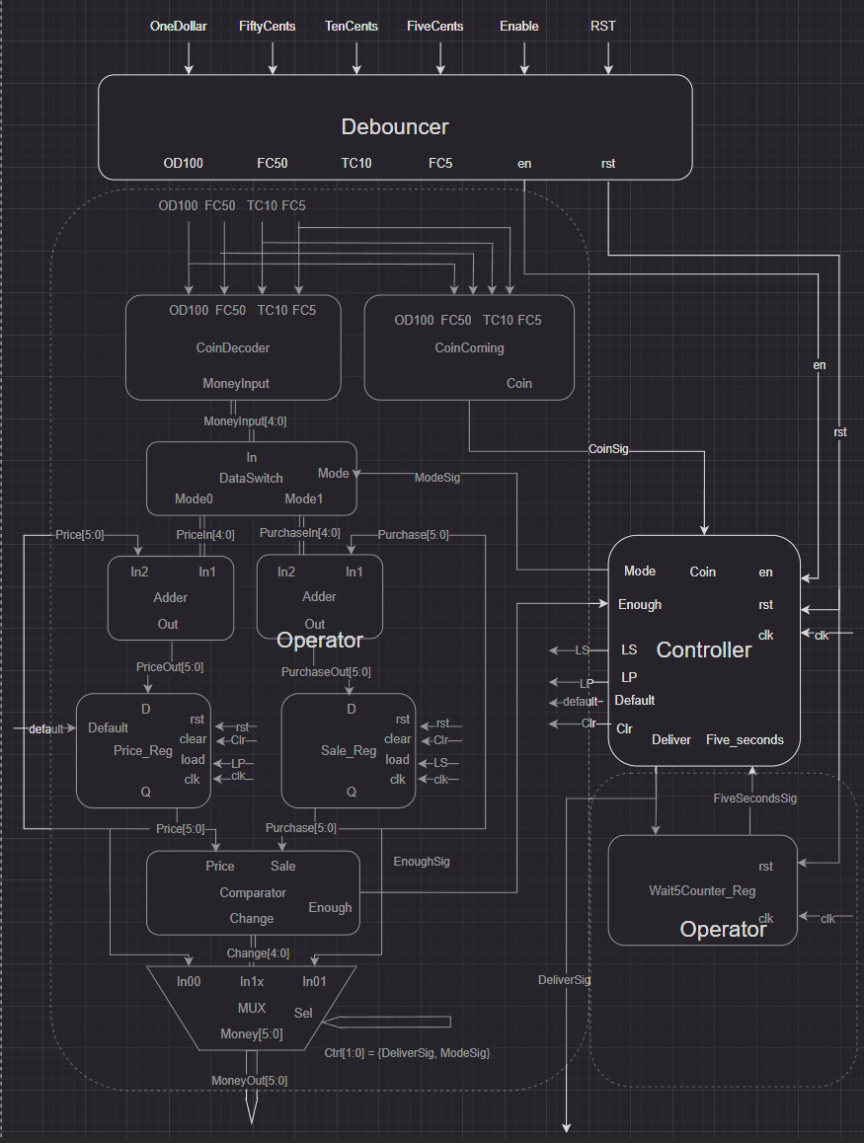
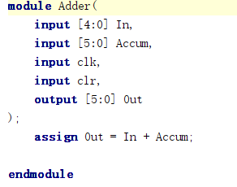
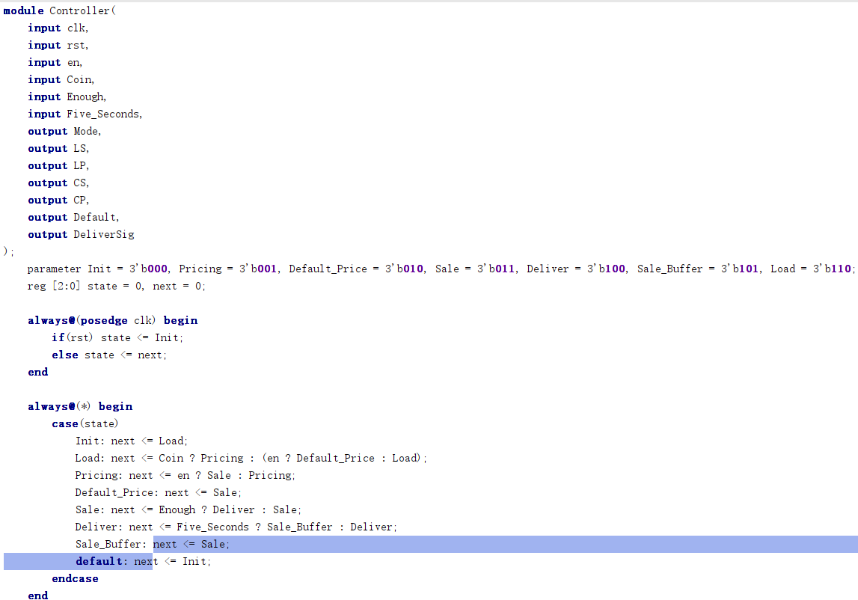
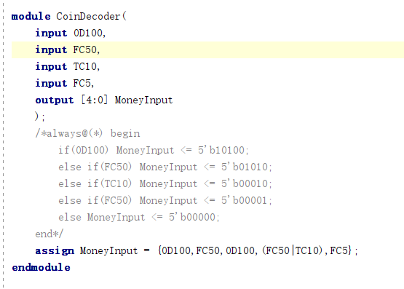
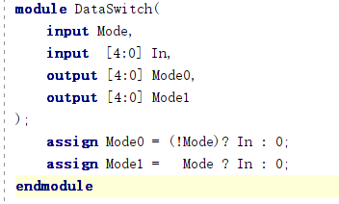
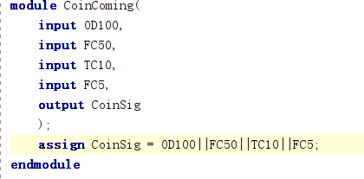
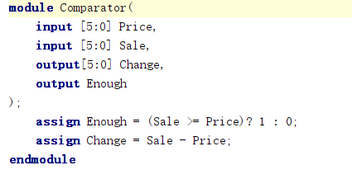
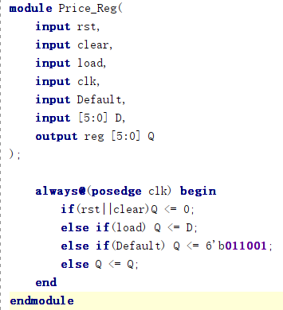
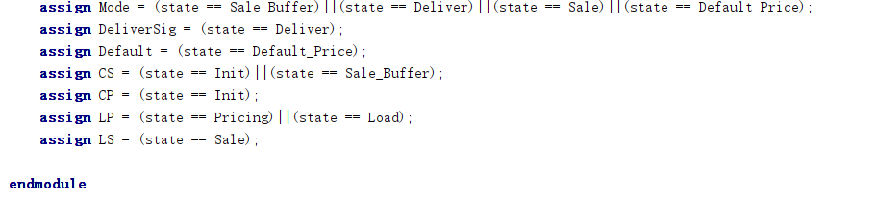
System block:
Controller：
Control the state transition:
Adder：
Calculate total value:
CoinDecoder：
Translate the input coins into specific money
CoinComming：
Store the price in register for later the use in later states
DataSwitch：
Decide whether its price setting or sale state
Comparator：
To see whether the money is enough for the purchase:
Price_Reg：
Store current value:

Slide 11
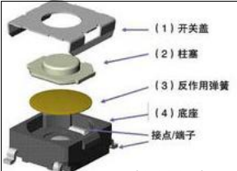
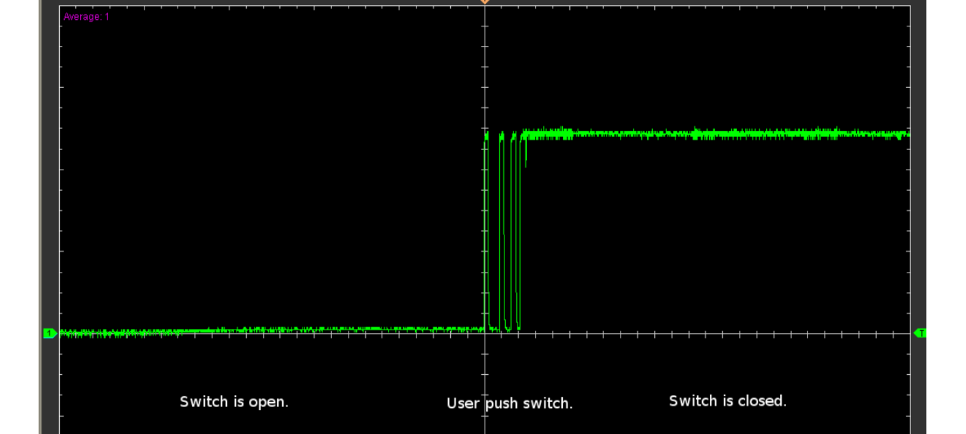
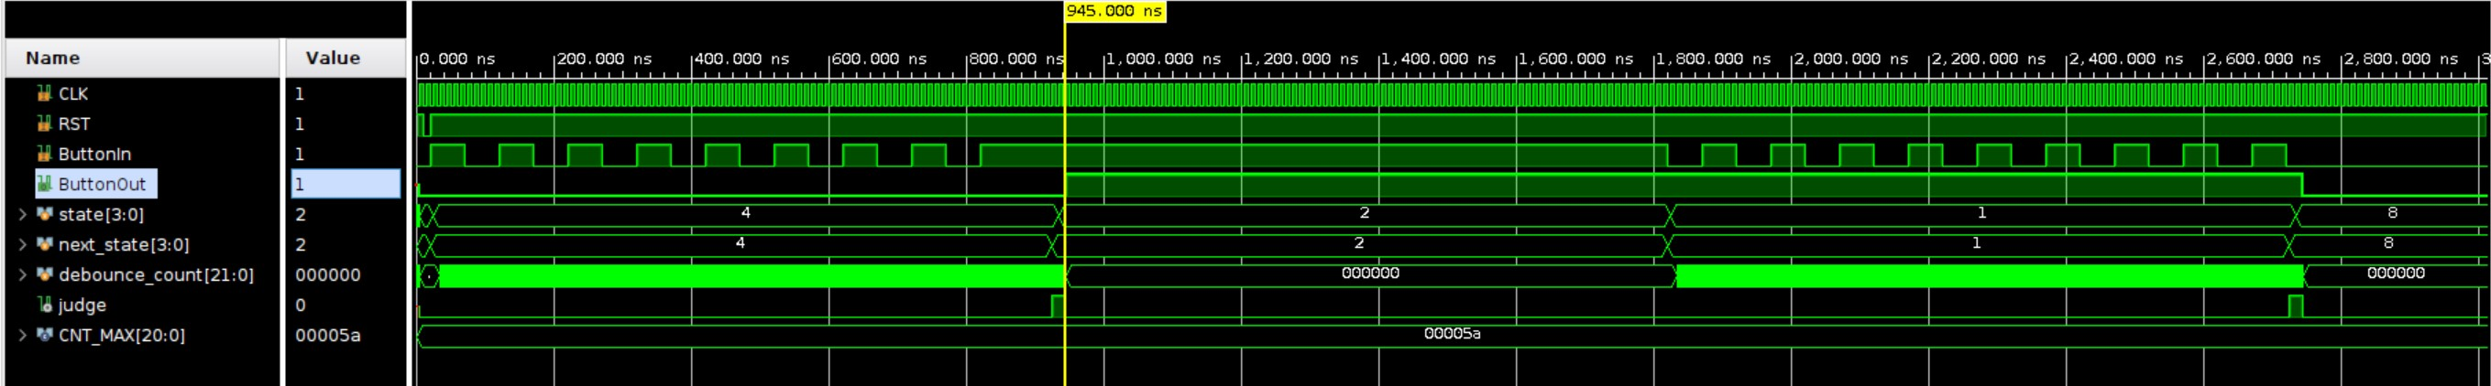
Switch Debouncing
Reasons for the need for debouncer:
In reality, when using keys and other modules to simulate the process of coin insertion, due to the jitter of the keys, we cannot generate a perfect square wave, and there will be burrs. Without key de-jitter, there will be multiple coin insertion at one key
One possible way to do this：
The FSM is used to start counting after the signal change is detected for the first time, and the square wave is output after the key input is stable for a certain time
Fig1: button structure
Fig2: pulse wave in real life
Fig3: bouncing wave in fpga

Slide 12
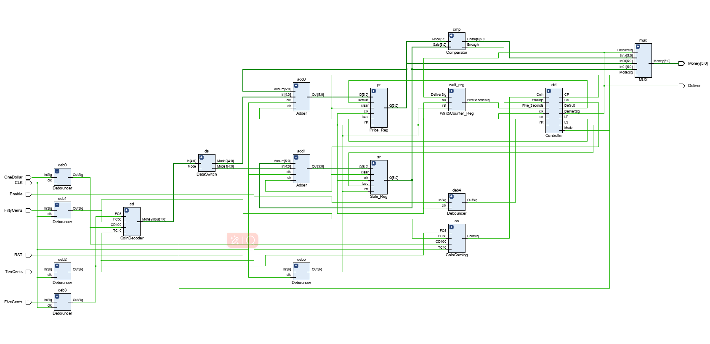
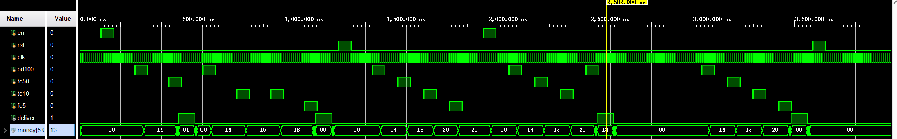
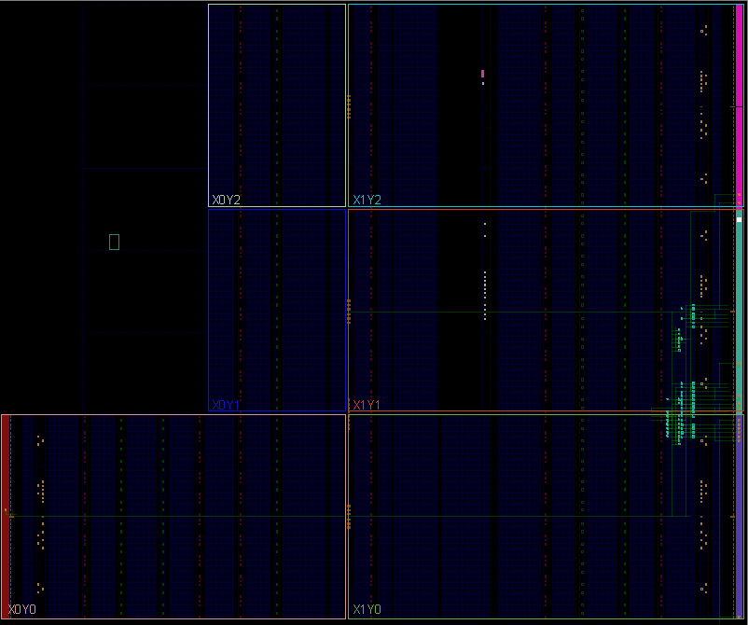
Human design - Evaluate:
Test 1：Default price 125
Input:
Coin_in=150
Price=125
Output:
deliver=1
Money=150-125=5*5
Test 5：Buy at price 165
Input:
Coin_in=165
Output:
deliver=1
Money=165-165=0*5
Test 4：Buy at price 165
Input:
Coin_in=260
Output:
deliver=1
Money=260-165=(1*16+3)*5
Test 3：Set price 165
Input:
Coin_in=165
Output:
Price=165
deliver=0
Money=165=(2*16+1)*5
Test 2：Default price 125
Input:
Coin_in=125
Price=125
Output:
deliver=1
Money=125-125=0*5

Slide 13
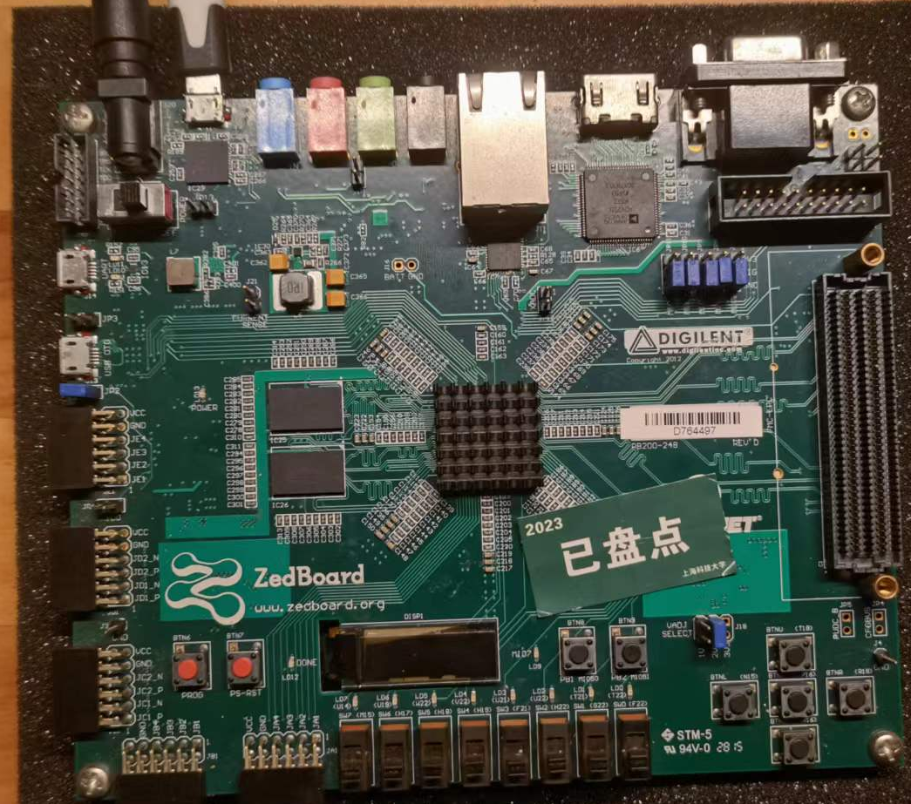
Human design – Evaluate: Zedboard

Slide 14
Conclusion:
LLM can complete the most basic requirements of the project in a very short time, while manual handwriting and debug took 3 to 4 times as long as LLM.
The final code given by LLM is done in the same module, which greatly reduces the possibility of extending its functionality. Manually written code separates the temporal logic from the combinational logic, which makes it highly robust and extensible.
The code written by LLM only focuses on the logic in the digital circuit and does not take into account the details of the use of this circuit in real scenarios. For example, it is not considered in LLM that the keys of a vending machine need the function of shaking elimination, and the change between states is in clock cycles, which means that we need to complete the purchase operation within a few nanoseconds.
The quality of the code written by LLM is limited. But, LLM can help zero-base users write code that performs basic functions. For experienced hardware engineers, LLM can also significantly improve productivity.

Slide 15
Thank you!

